Slide 1
THE WORLD vs COVID-19
MARCH 24, 2020
Matt Duong
Shreya Sachdev
Shehroze Ahmed
Dev Singh
Dan Chang
Notes:
Title Slide
* Include the name of the Project and Group Members

Slide 2
Hypothesis
The mortality rate of COVID-19, would be safeguarded by a country’s lower median age, higher hospital beds per 1000, and higher health budget per capita
Notes:
DAN
* Motivation & Summary Slide
* Define the core message or hypothesis of your project.
- Initially, we had actually ventured off to create a completely new metric, which we coined the “Dan Metric” which essentially was derived from 8 key factors which you’ll see on the next slide.
- With these key variables, we wanted to provide scores to countries, and then use this score as a predictive value to see how other countries which had yet to be greatly affected, would handle COVID-19
- There were many complications to this initial question we had about the “Dan Metric” though
- At the beginning of the project, it may have been fine, but again, as we moved forward, our scope of the data available also changed
- It also was then attributed that there are many other factors (other than the 8 we had chosen), which could contribute to a country’s success in safeguarding against the virus
- Media attention
- Levels of “lock down”
- Testing availability
- Ventilators

Slide 3
Questions we asked ourselves
With COVID-19 happening in the present, how does this affect the scope of the questions we would want to solve for?
What factors would be correlated to the number of confirmed cases?
What factors would be correlated to the mortality rate of COVID-19?
What is the “truth” about COVID-19, based off of what we’ve been observing or experiencing through media coverage?
Notes:
SHEHROZE
* Describe the questions you asked, and _why_ you asked them
* Describe whether you were able to answer these questions to your satisfaction, and briefly summarize your findings
Question 1:
- Definitely more challenging to manage a project where the scope of our data evolved every single day
- That being said, it was a bit of a double edged sword
- On one hand, it allowed us access to greater amounts of data which was much needed, since data was very limited to begin with
- On the other hand, it forced us to make adjustments to our code at some points to account for any new variables included in the updated data sets
Question 2 and 3:
- Previously I had mentioned that we initially had a different scope on how we would want to approach this project, that being said, we felt it was equally important to discuss the fundamentals of a country’s economy, and health standards prior to diving any further.
- Therefore, the scope of our project is more shallow, and likely would be until we are past this entire ordeal
Question 4:
- Was more a general question that we kept in the back of our minds as we worked through this project. I’m sure a lot of us have kept up with the trends on media and news for COVID-19.
- Was this news going to create a bias for what we wanted to analyze?
- How did we make sure to look at the fundamental aspects to ensure that we had an understanding of COVID-19 and it’s effects

Slide 4
Data we needed to find
COVID-19 data
Confirmed/Cured/Deaths
Confirmed cases per 100 000
Mortality rate of COVID-19
Country data
GDP per capita
Median age
Life expectancy
Health budget per capita
Hospital beds per 1000 people
Unemployment rate
Poverty rate
Literacy rate
Notes:
DAN
* Questions & Data
* Elaborate on the questions you asked, describing what kinds of data you needed to answer them, and where you found it
Our data came from many sources,
COVID-19 – retrieved this rolling data through GIS
Then derived our own metrics for confirmed cases per 100 000 (for each country)
Derived our own metric for mortality rate of COVID-19 (for each country)
Country metrics and data were collected from a number of sources:
CIA Factbook
World Population Review
World Health Organization

Slide 5
Data Cleanup & Exploration
Exploration and Cleanup Process:
Cleaning of country names
Finding standardized data for all countries
Formatting data in a useful way
Notes:
MATT
* Data Cleanup & Exploration
* Describe the exploration and cleanup process
* Discuss insights you had while exploring the data that you didn't anticipate
- mortality rate, and “spread rate” vs median age
* Discuss any problems that arose after exploring the data, and how you resolved them
- country names differed, or countries were divided into states/provinces
- found ways to merge this data
- country data was missing from some data sets or many smaller countries just didn’t have data
- needed to make a decision if these countries were valid to be included in our data set
- decided that only countries without any data whatsoever were excluded
- found that Jupyter Labs was one of the most useful when writing the code itself, however! Discovered that Jupyter Lab does not allow you to use map visualization, so needed to weight on Jupyter Notebook for this portion
- optimized curves, although we felt that some of our data would be best represented using a logarthicmic regression line, it was something which we struggled to present today

Slide 6
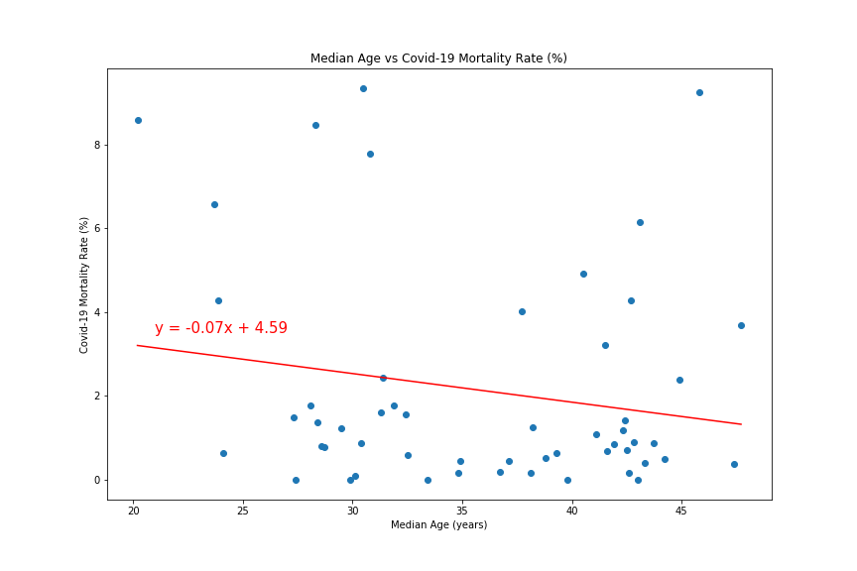
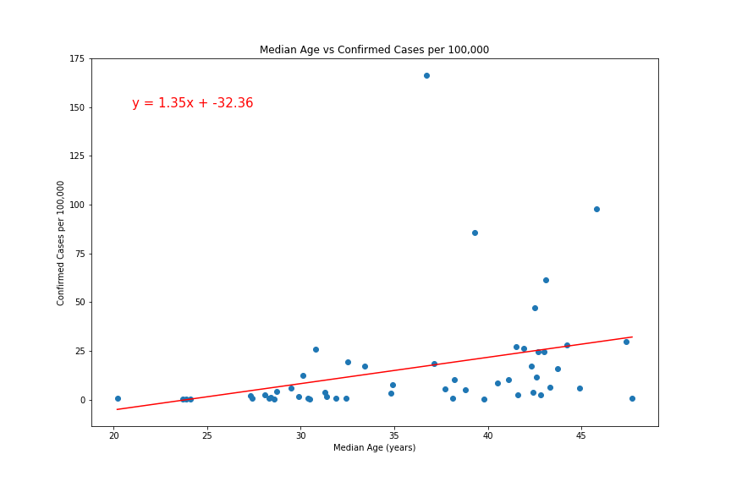
Median Age vs Mortality Rate and Confirmed Cases
Notes:
SHREYA
* Present and discuss interesting figures developed during exploration, ideally with the help of Jupyter Notebook
* Data Analysis
* Discuss the steps you took to analyze the data and answer each question you asked in your proposal
* Discuss your findings. Did you find what you expected to find? If not, why not? What inferences or general conclusions can you draw from your analysis?
LEFT PLOT
- This plots the Median age against the Mortality Rate for Covid-19. Our observations are:
- We can see a mild negative correlation between the two factors
- The higher the median age, the lower the mortality rate
RIGHT PLOT
- This plots the Median age against the number of confirmed cases per 100,000 people. Our observations are:
- We can see a medium positive correlation between the two factors
- The higher the median age, the greater the likelihood of contracting COVID-19
Findings:
- The result here makes sense, however as a group we were still surprised to see the negative correlation for the Median age and Mortality Rate of COVID-19 so far.
-

Slide 7
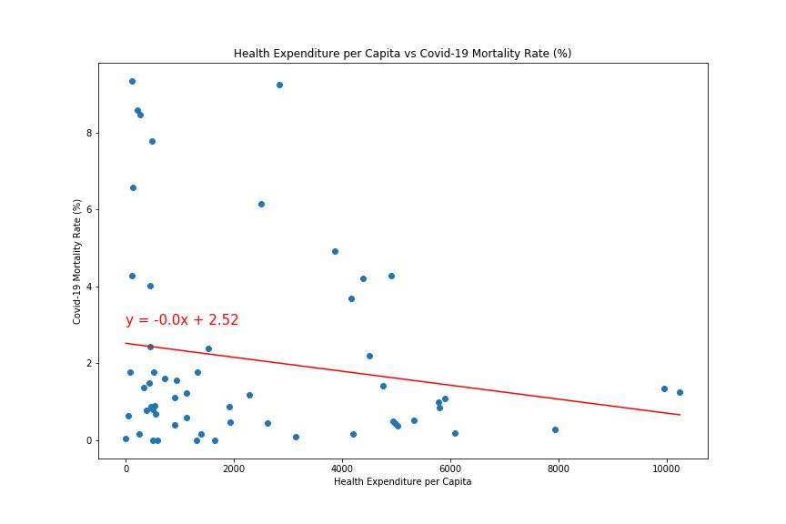
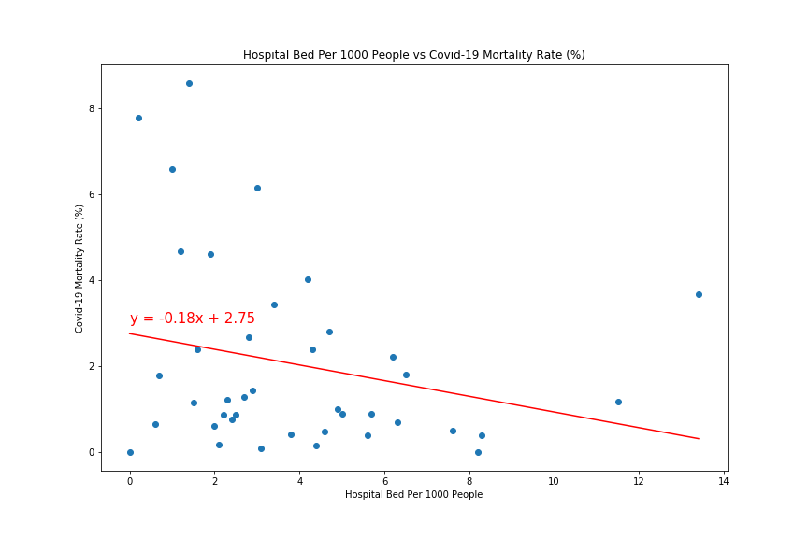
Health Expenditure per Capita and Hospital Beds per 1000 people vs Mortality Rate
Notes:
SHREYA
* Present and discuss interesting figures developed during exploration, ideally with the help of Jupyter Notebook
* Data Analysis
* Discuss the steps you took to analyze the data and answer each question you asked in your proposal
* Discuss your findings. Did you find what you expected to find? If not, why not? What inferences or general conclusions can you draw from your analysis?
LEFT PLOT
- This plots the Health Expenditure per Capita against the Mortality Rate for Covid-19. Our observations are:
- We can see a mild negative correlation between the two factors
- The higher the Health Expenditure per Capita, the lower the likelihood of survival
RIGHT PLOT
- This plots the Hospital Beds Per 1000 people against the Mortality Rate for Covid-19. Our observations are:
- We can see a medium negative correlation between the two factors
- The higher the number of Hospital Beds Per 1000 People, the higher the likelihood of survival
FINDINGS:

Slide 8
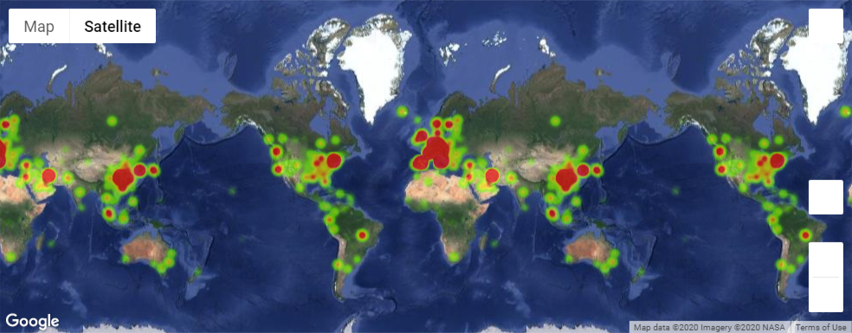
Number of confirmed cases
Notes:
DEV
* Present and discuss interesting figures developed during exploration, ideally with the help of Jupyter Notebook
* Data Analysis
* Discuss the steps you took to analyze the data and answer each question you asked in your proposal
- For the next two heat maps, it wasn’t necessarily used on an analytic standpoint, but was more for validating the information which we already had, to the many other sources that can be found

Slide 9
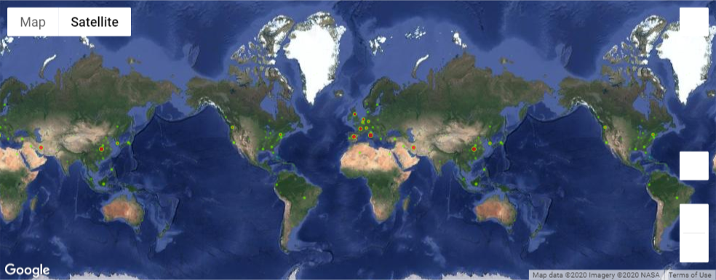
Number of deaths
Notes:
DEV
* Present and discuss interesting figures developed during exploration, ideally with the help of Jupyter Notebook
-
* Data Analysis
* Discuss the steps you took to analyze the data and answer each question you asked in your proposal

Slide 10
Additional questions and considerations
Additional data sets:
Population density
Ventilators per 1000 people
Vaccine development
Stage of quarantine or “lock down”
Border enforced
Curfew
Martial law
Additional visuals:
Interactive timelines for heatmap
Heatmaps based on trends in a country
Notes:
DEV
* Post Mortem
* Discuss any additional questions that came up, but which you didn't have time to answer: What would you research next, if you had two more weeks?
Realistically, with the limited data which we have on the subject (and skewed data based on countries providing data)
Looking at data once vaccine is developed (hopefully that will happen within 2 weeks)
Finding additional missing data, population density, ventilators, vaccine development, were all things we could have considered, and would likely have
Timeline on heat maps
Plotting heatmaps based on any trends that we could find (as opposed to just plotting data points)

